Slide 1

DEPARTMENT OF ARTIFICIAL INTELLIGENCE AND DATA SCIENCE ACADEMIC YEAR 2025 - 2026 SEMESTER III ARTIFICIAL INTELLIGENCE LABORATORY MINI PROJECT REVIEW <TITLE OF THE PROJECT>
REGISTER NUMBER | 2117240070024
NAME | ANISHA V
YEAR | II
SECTION | A
FACULTY IN-CHARGE | Mrs. M. Divya

Slide 2
PROBLEM STATEMENT
To develop an AI-based guessing system that can identify a user’s chosen number within a defined range by using logical reasoning and feedback-based learning.
The system should:
Take user feedback (“high”, “low”, or “correct”) after each guess.
Narrow the search range based on the feedback.
Arrive at the correct answer in the minimum number of steps.

Slide 3
THEORETICAL BACKGROUND
Theoretical Background:
AI enables machines to think and decide logically.
Game uses Binary Search and feedback logic to guess numbers.
Literature Survey:
Traditional guessing → random, inefficient.
Binary Search → fast, logical, feedback-based.
ML can improve by learning user behavior.
Justification:
Efficient (O(log n))
Simple, logical, human-like reasoning
Fewer guesses than other methods
Algorithm (Example):
Range: 1–100
Guess mid → get feedback
Too high → decrease range
Too low → increase range
Repeat till correct (e.g., number = 73 → guessed in 7 tries)

Slide 4
IMPLEMENTATION AND CODE
Link to code in Git-hub Repository
List | Git-hub Repository Links
Implementation of Code Link | https://github.com/anisha-39/Guess-The-Number-AI
Word Document Report Link | guess the number AI report.docx
PPT Link | AILAB_MINI_PPT_TEMPLATE_AI^0DS[1].pptx

Slide 5
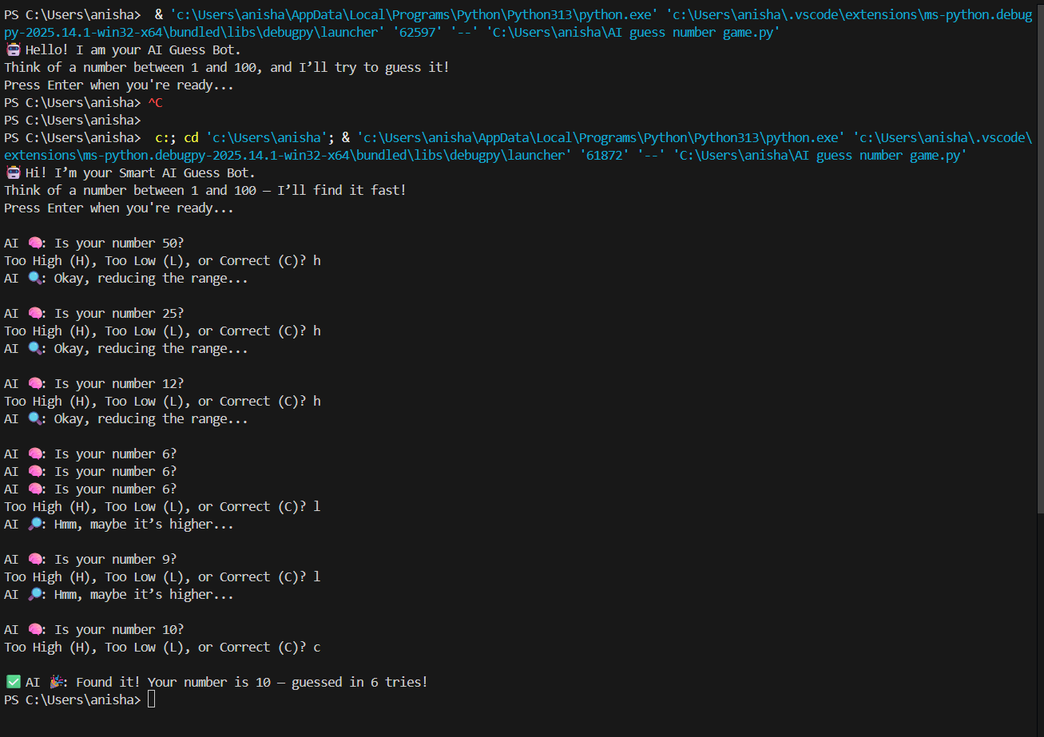
OUTPUT AND RESULTS

Slide 6
OUTPUT AND RESULTS
Explanation:
AI guesses user’s number using Binary Search logic.
Feedback (“High/Low/Correct”) refines the range each time.
Process repeats until the exact number is found.
Results:
AI accurately predicts the user’s number.
Requires minimal guesses (log₂n steps).
Shows intelligent, human-like reasoning.
Future Enhancements:
Add voice interaction (speech input/output).
Create GUI using Tkinter or Streamlit.
Use Machine Learning to adapt to user patterns.

Slide 7
REFERENCES
Russell, S. & Norvig, P. (2021). Artificial Intelligence: A Modern Approach (4th Edition).
GeeksforGeeks – “Binary Search Algorithm” https://www.geeksforgeeks.org/binary-search/
TutorialsPoint – “Artificial Intelligence Overview” https://www.tutorialspoint.com/artificial_intelligence/index.htm.
W3Schools – “Python while Loops and Conditional Logic” https://www.w3schools.com/python/python_while_loops.asp

